Slide 1
Magic Chef
Academy Final Project
Submitted to:
Eurisko AI Team
Prepared By:
Charbel Daher and Taline Ouayjan

Slide 2
Table of contents
01
02
03
04
05
Introduction
Overview
Challenges & Solutions
Transforming Culinary Experiences
The entire pipeline, from data preprocessing to the user interface
Challenges encountered during development and the way we overcome them
Areas of Improvement
Conclusion
Future work for system enhancement
A Successful Personalized Recipe Recommendations System

Slide 3
Introduction
01
Introduction on the project's purpose, goals, and significance in the digital culinary world.

Slide 4
to Our Project
Introduction
In the era of digital transformation, to enhance user experiences across different platforms, personalized recommendations have become a must. The culinary world is increasingly demanding intelligent, sophisticated recipe recommendation systems that can deliver customized recipe suggestions tailored to individuals depending on their preferences and dietary needs.
Focus Areas:
User preferences like recipe titles, preparation/cooking time, ingredients.
Project challenges and solutions.
Examination of the system's design, function, and potential improvements.
Goal:
Enhance the way users discover and choose recipes through advanced, customized recommendations.

Slide 5
Overview
02
From data cleaning to the user interface

Slide 6
Feature Engineering step
User Interaction and Feedback
MAGIC CHEF processes multiple datasets, extracting features and calculating embeddings to match recipes with user preferences.
Users can rate and review recipes, providing feedback that refines future recommendations for a personalized experience

Slide 7
The flow adapted
Data Visualization
Data Aggregation and Preprocessing
Embedding Calculation and Storage
Filtering and Prediction
Translation Feature
User Interaction and Embedding Updates

Slide 8
Continued…
User Interface
Reviews Feature
Submitting your own recipe Feature

Slide 9
Lets delve deeper!

Slide 10
—George Fuechsel
“Garbage in, Garbage out”

Slide 11
Data Aggregation and Preprocessing
Multiple Datasets
Standardization
We combined four datasets from HuggingFace and one from Kaggle into a single one
Mapping of all the data to the same data model to ensure consistency
Text Normalization
Handling Missing Data
Converting texts to lowercase and removing unnecessary spaces
Filling in defaults and dropping some

Slide 12
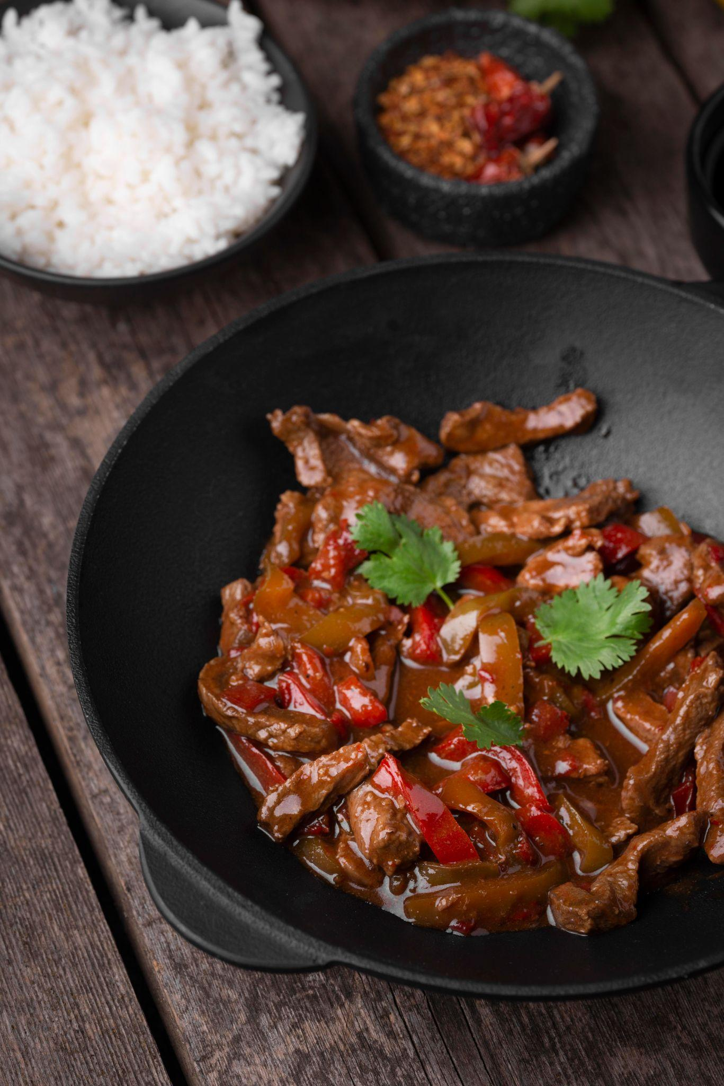
Embeddings Calculations & Storage
Calculated using the Jina-CLIP model.
Designed to handle multimodal data (text & images).
They are stored in a JSON file.
Indexed by recipe ID.

Slide 13
Data Visualization
Cuisine Distribution
Course Distribution
Diet Distribution
Preparation/Cooking Time Distribution

Slide 14
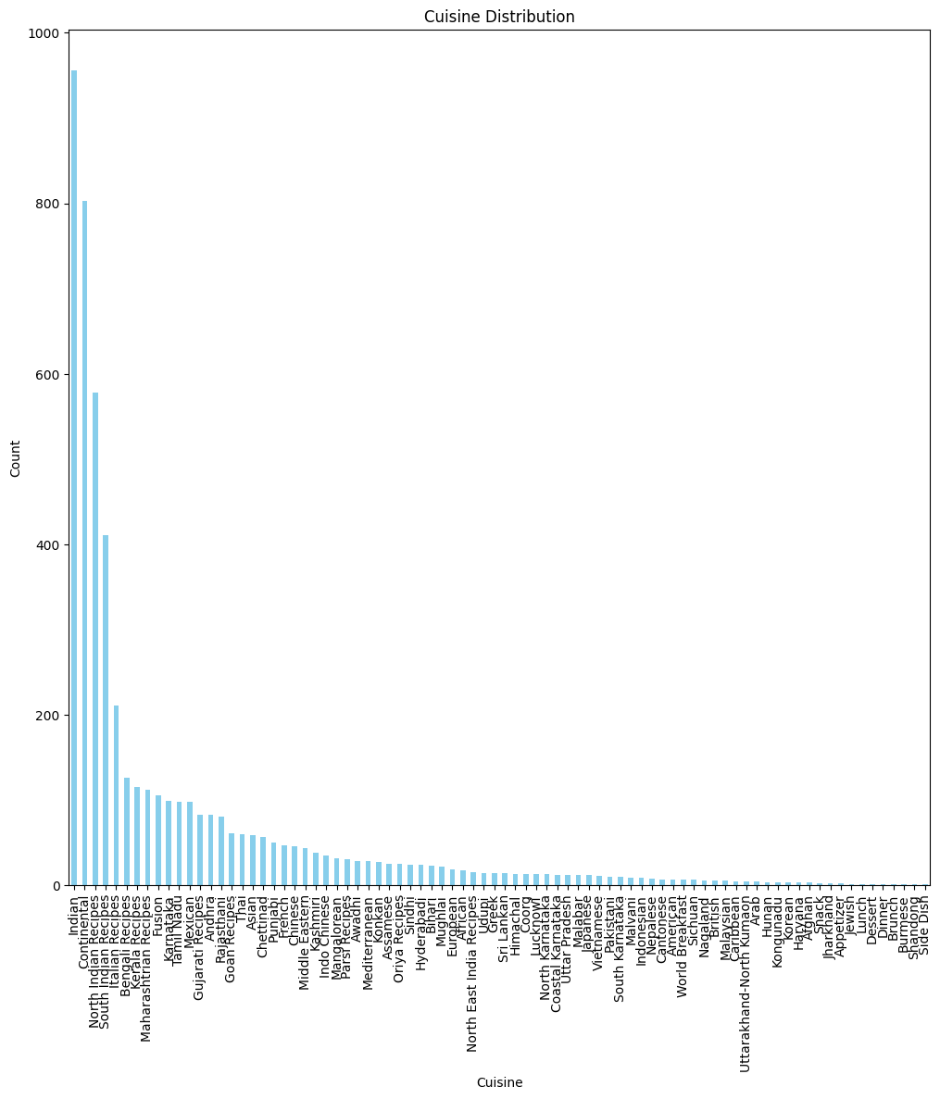
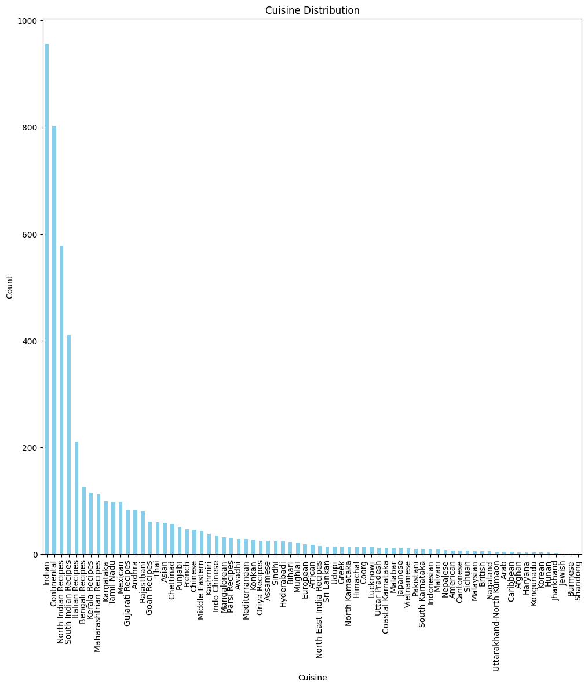
Cuisine Distribution
After Cleaning
non_cuisine_values = [ 'Appetizer', 'Brunch', 'Dessert', 'Dinner', 'Fusion', 'Lunch', 'Side Dish', 'Snack', 'World Breakfast’ , ‘Gujarati Recipes\ufeff’]
82 unique cuisines
72 unique cuisines

Slide 15
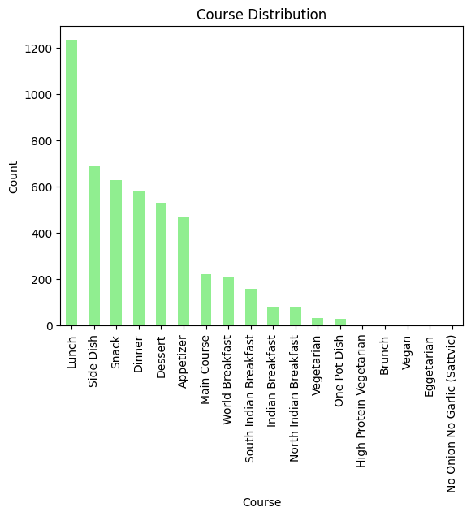
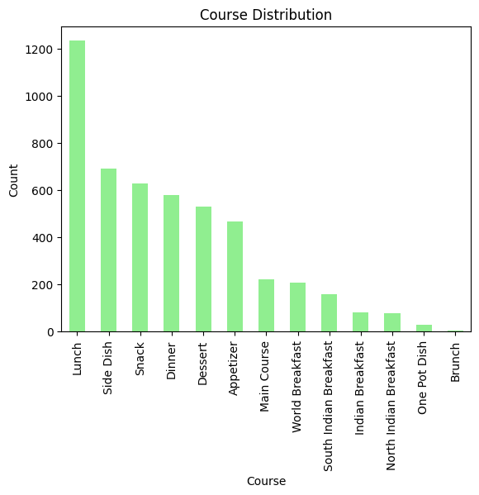
Course Distribution
After Cleaning
non_course_values = [ ‘Vegetarian’, ‘High Protein Vegetarian’, ‘Vegan’, ‘Eggetarian’, ‘No Onion No Garlic (Sattvvic)’]
18 unique courses
13 unique courses

Slide 16
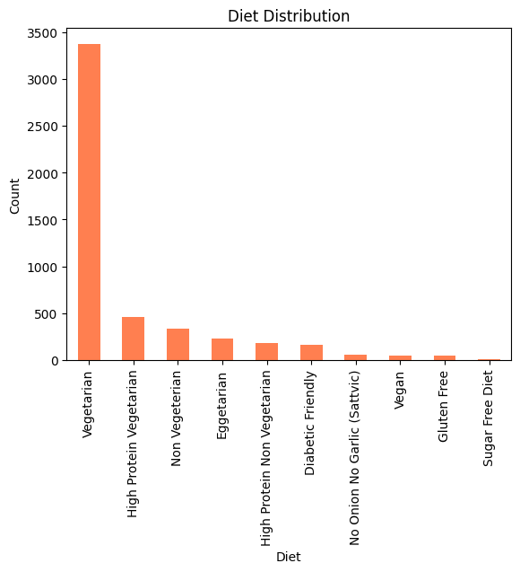
Diet Distribution
Data is already cleaned here!
10 unique diets

Slide 17
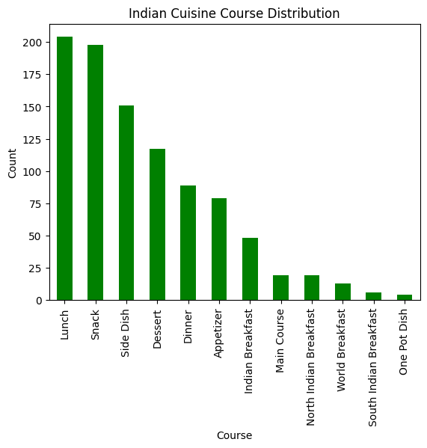
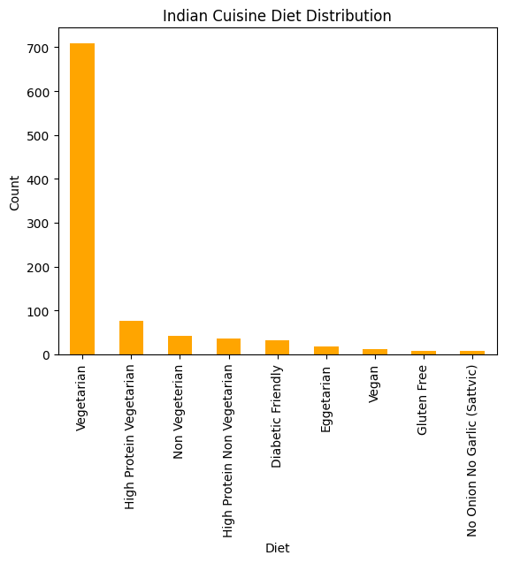
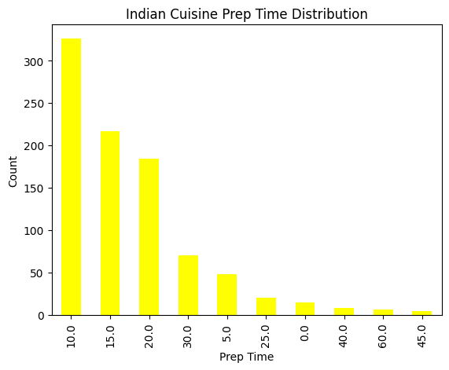
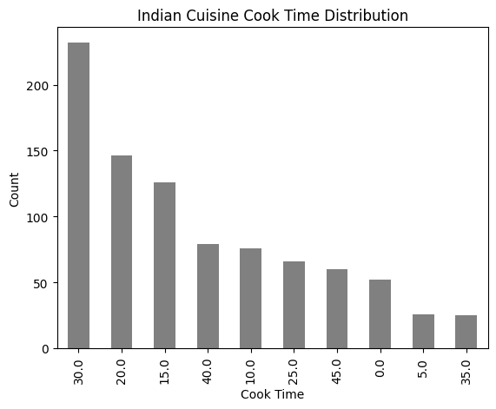
Indian Cuisine Distribution
Analysis of Indian cuisine according to Course/Diet/Prep Time/Cooking Time.

Slide 18
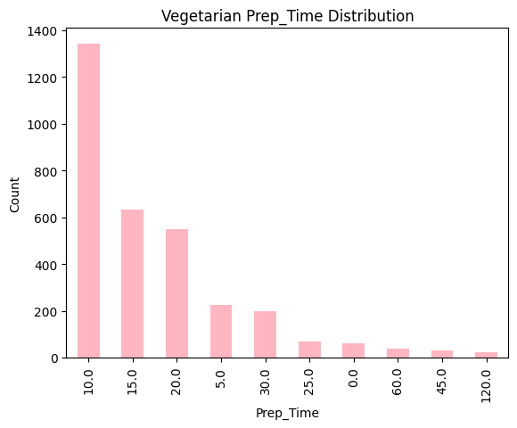
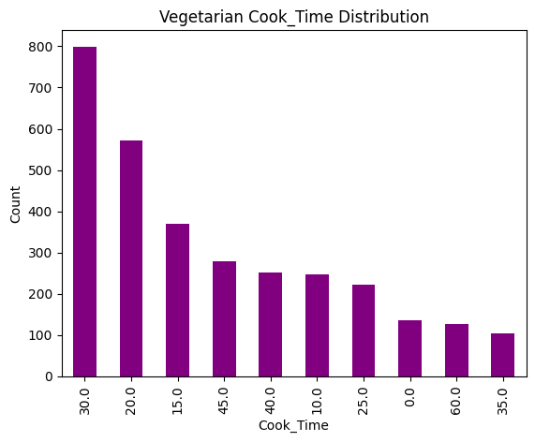
Vegetarian Diet Distribution
Analysis of Vegetarian diet according to Prep Time/Cooking Time.

Slide 19
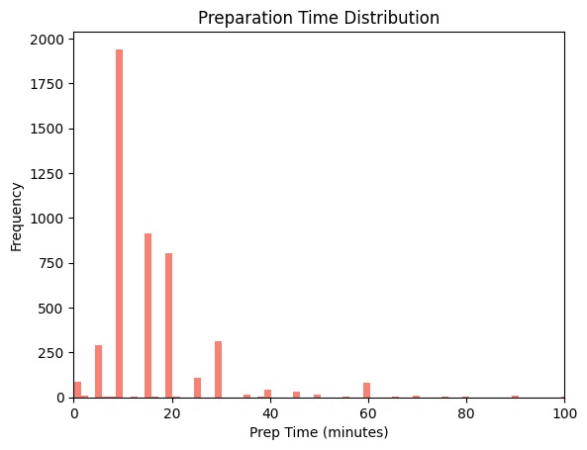
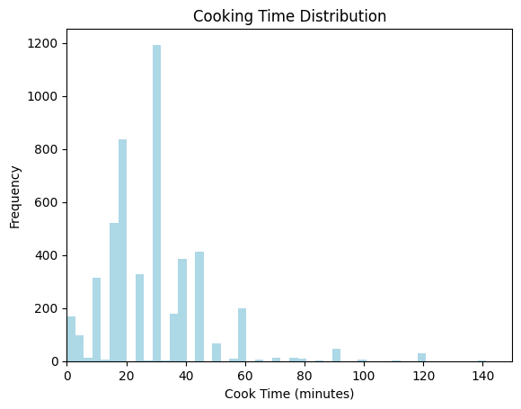
Preparation/Cooking Time Distribution
Analysis of Prep Time/Cooking Time.

Slide 20
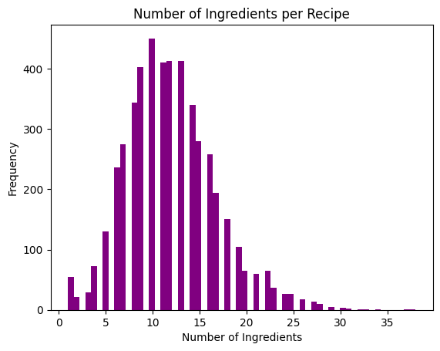
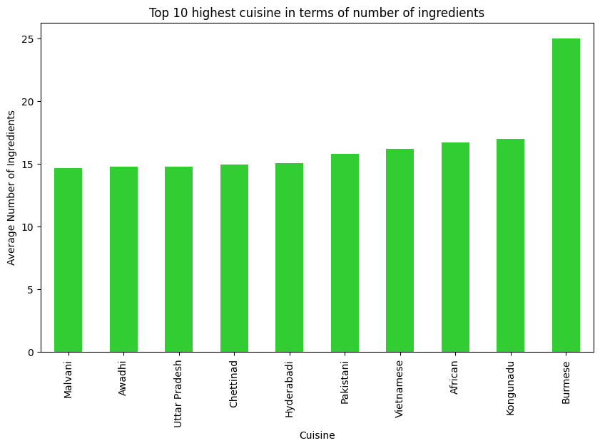
Number of Ingredients Analysis

Slide 21
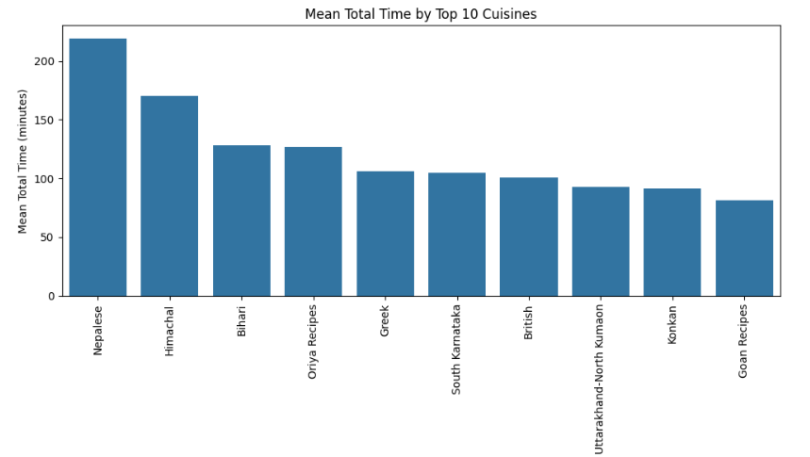
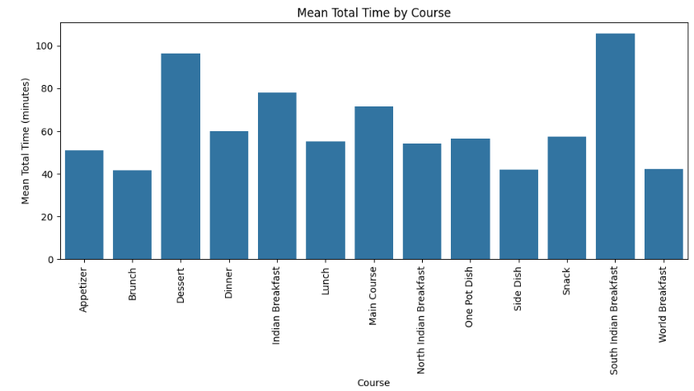
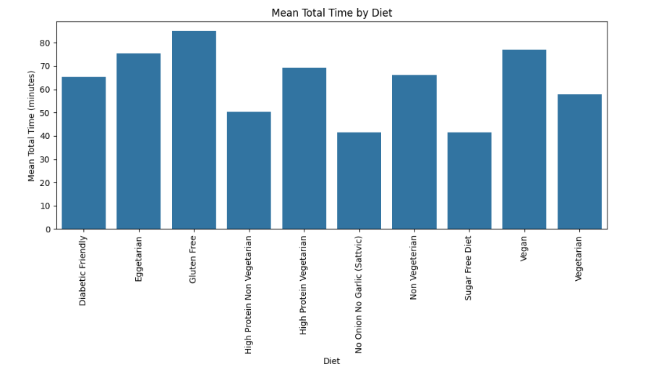
Mean Total Time Analysis
Analysis of Total Time according to Cuisine/Diet/Course distribution.

Slide 22
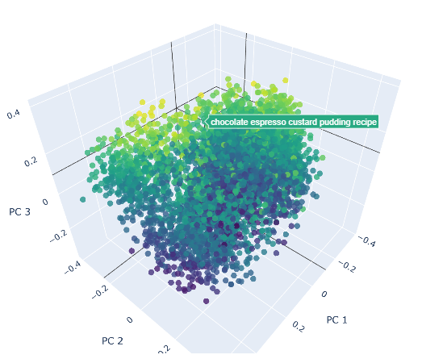
PCA
In order to be able to visualize the close recipes, we applied PCA on the embeddings and visualize it on a 3D space.

Slide 23
Filtering and Prediction
Filtering the initial df based on user inputs
Return top n most similar recipes
Cosine similarity
Calculate the embedding of the user input

Slide 24
Translation
Users have the ability to enter the recipe description in Indian language
Our code detects the Indian language
Do all the calculation and work on the English version on the text
Return the results in Indian

Slide 25
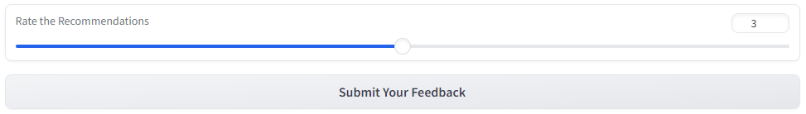
Feedback
This number affect the weights of the new embedding on the previous

Slide 26
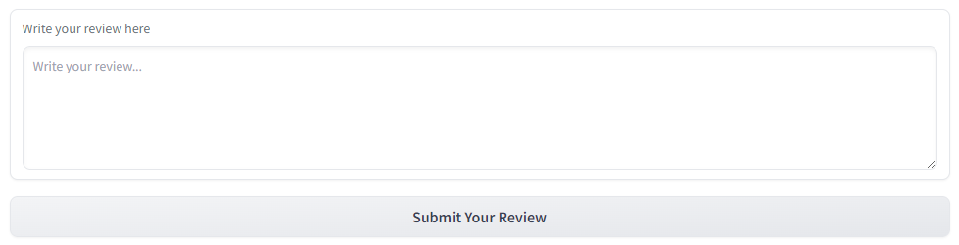
Review
Reviews are saved in a csv file so we can inspect them later and improve our app

Slide 27
Recipe add
User add his own recipe
It is added to a csv only we as admin have access to
Add it to the data
Gets our approval

Slide 28
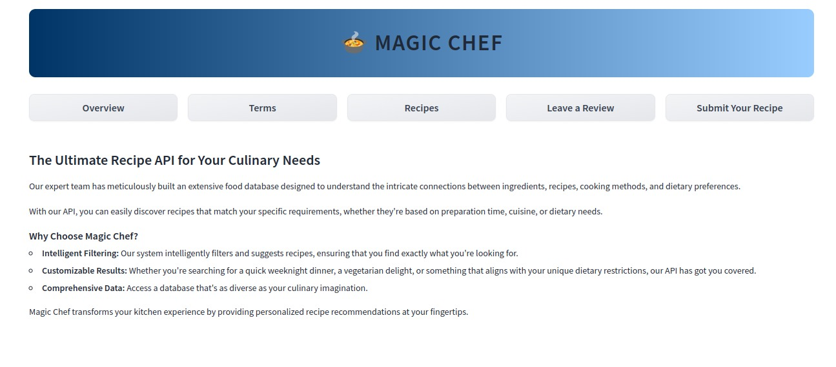
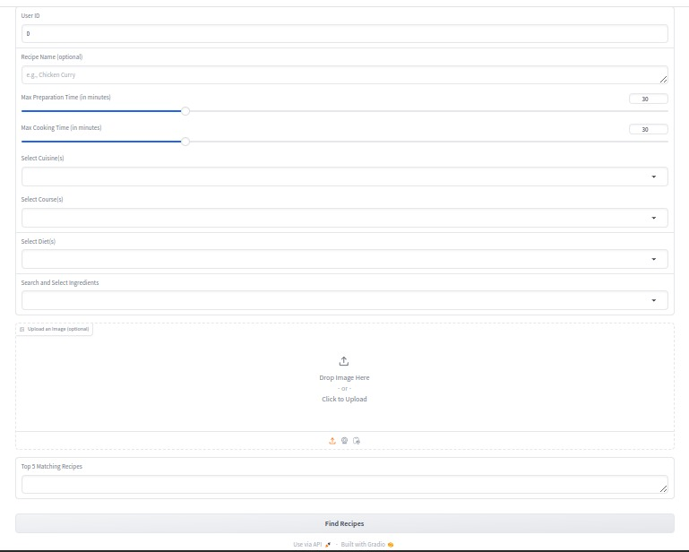
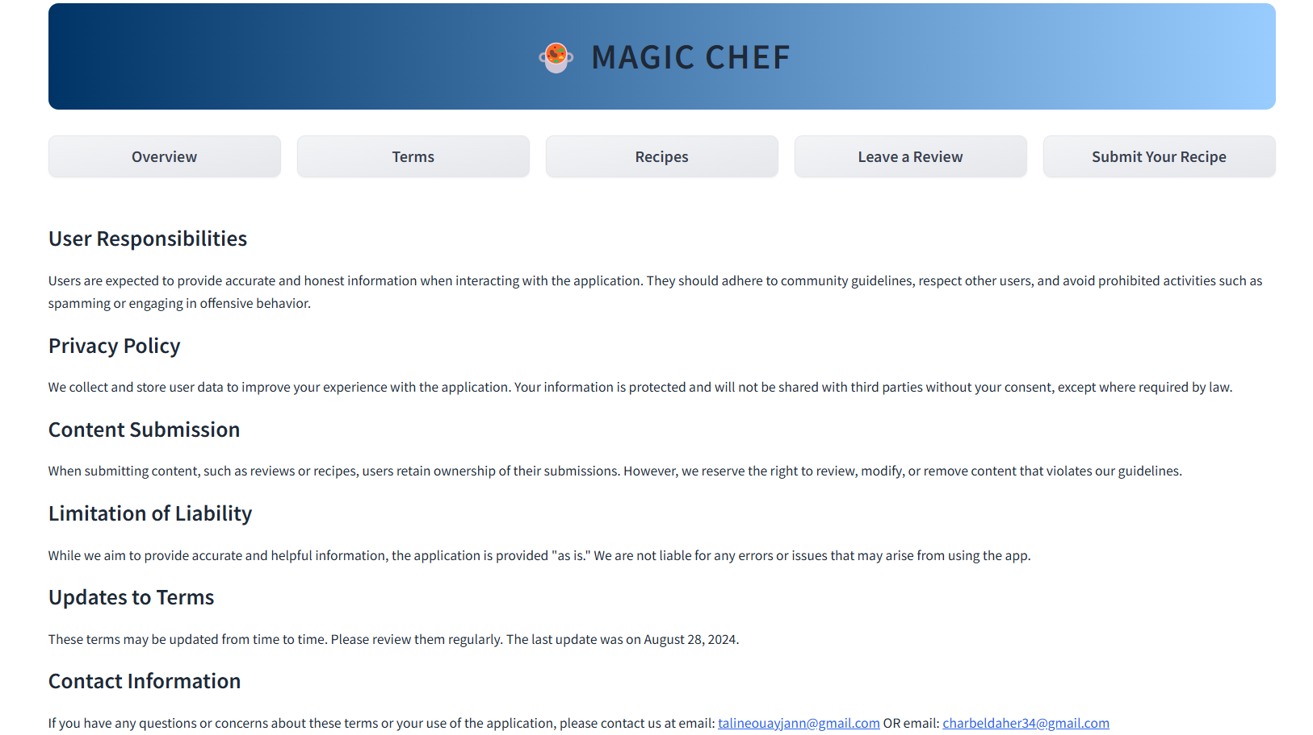
Gradio Pages
Overview/Terms/Recipes Pages.

Slide 29
Docker
API
GRADIO
DOCKER COMPOSE

Slide 30
Challenges & Solutions
03
Discussion of the challenges encountered during the development of our project and the solutions adapted to overcome them.

Slide 31
Challenges
Data type
Image and Text Embedding
Dataset Integration and Standardization
Dockerizing the application
Ingredient extraction
Filtering and Matching Recipes

Slide 32
Areas of Improvement
Scalability
Use Databases.
Diverse Input Types
Machine learning for recipe approvals
Voice/Audio Inputs.
Multi-Language Support
Advanced Filtering Options
Expand to new languages.
Allergy based filtering.

Slide 33
Thank you!
Questions, Suggestions, or Feedback?

